Slide 1
THG Simulations
Project update
Week 3 (B)
09/08/2023
David Amorim

Slide 2
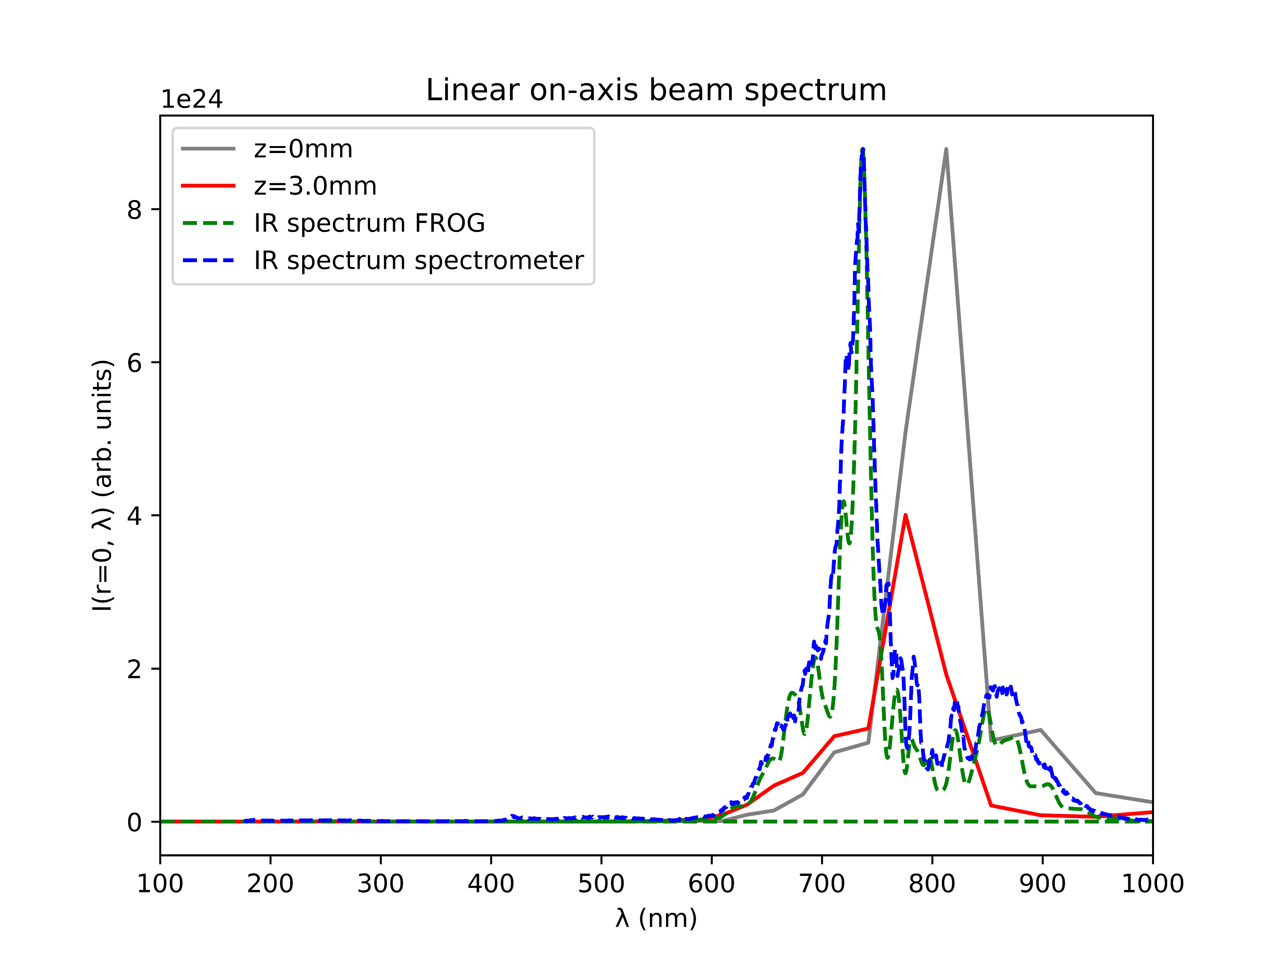
Comparison of spectra
IR spectrum calculated from FROG largely agrees with IR spectrum measured by spectrometer
The shape of the spectra also agree with the simulated IR spectrum (grey)
However, the measured spectra are centred around 730nm, not 800nm
Set the central wavelength to 730nm in the simulations?

Slide 3
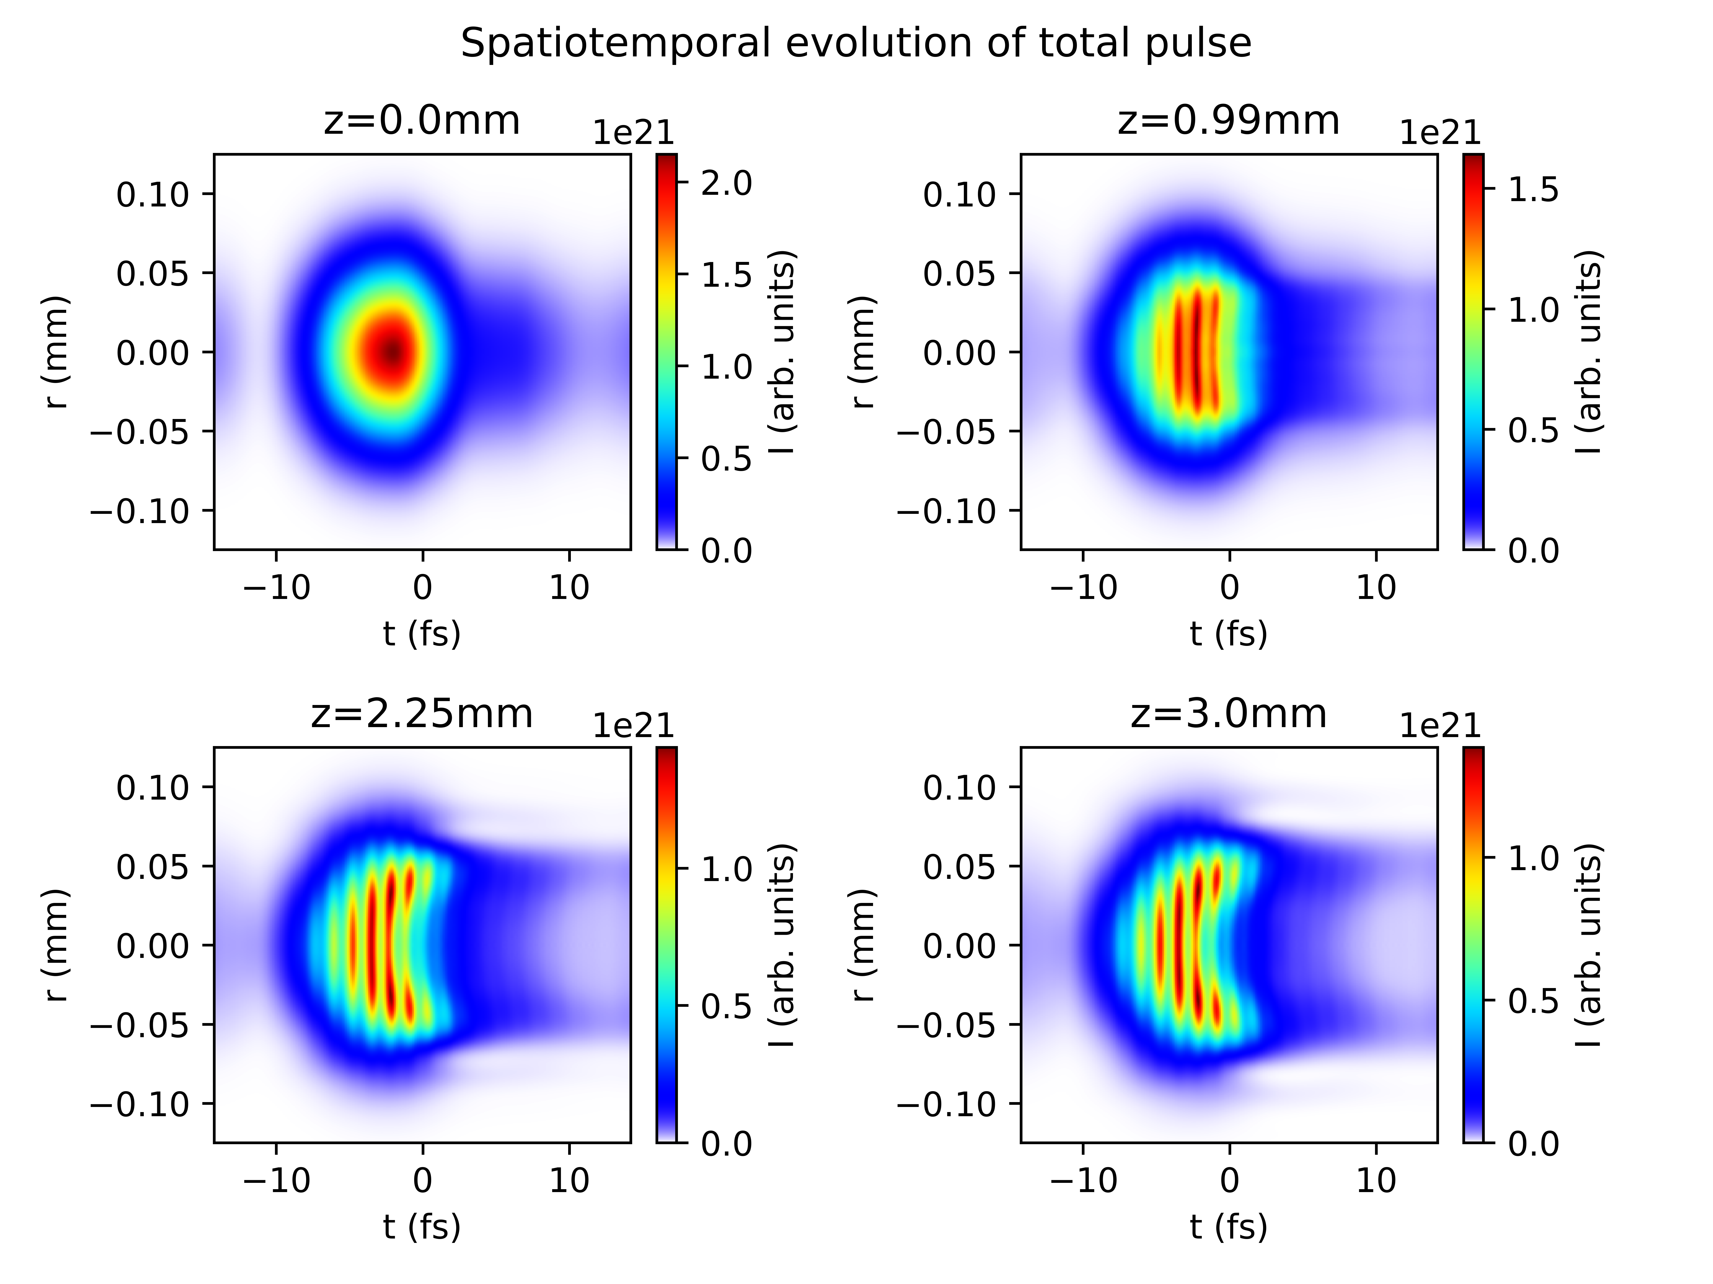
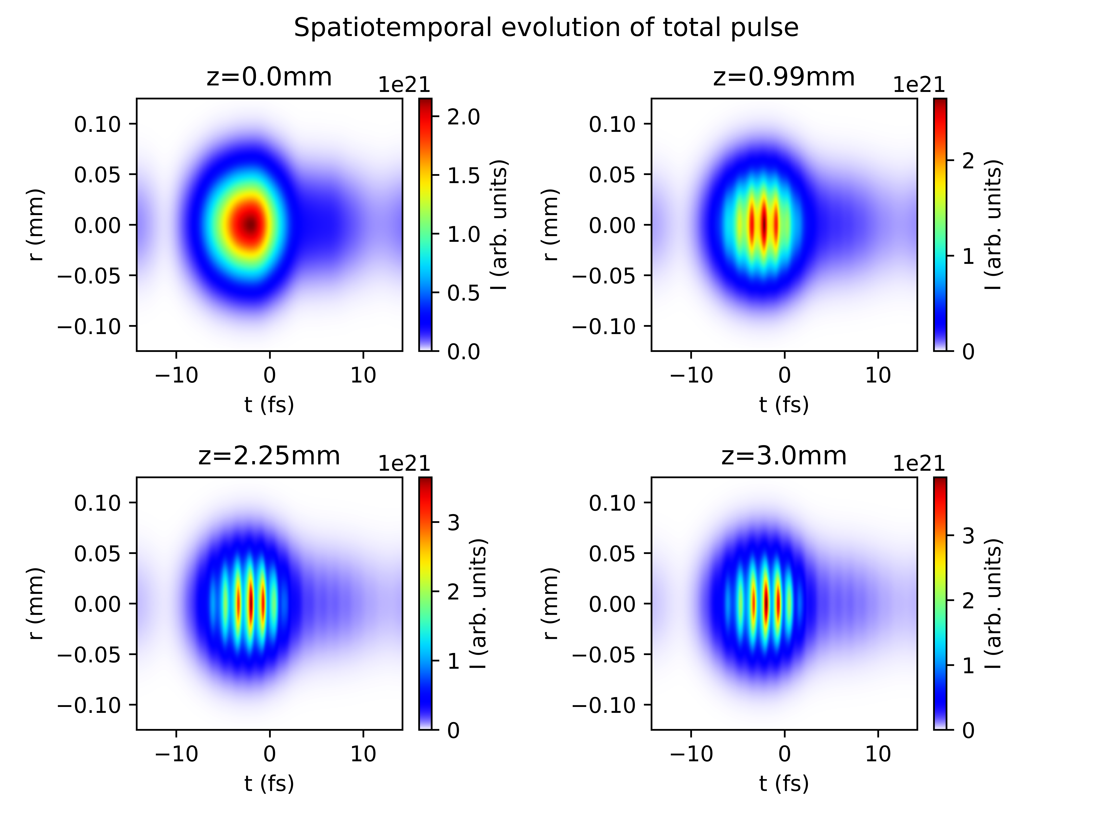
Reproducing plots from Reiter et al. 2010
In the following: 150mW Argon at 1.0 bar
ion
No ion

Slide 5
List items for discussion with Chris (Luna)
Lacking documentation for Nonlinear.jl response functions
in particular: how do KerrField, PlasmaCumtrapz, etc. relate to specific terms in the UPPE?
Extracting temporal/spectral phase information

